Slide 1
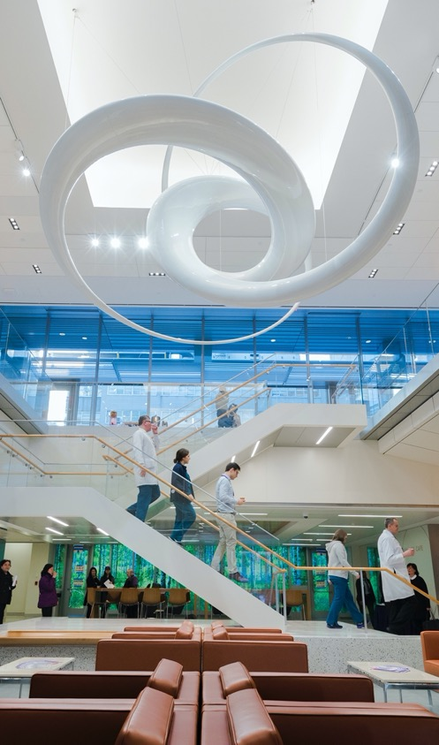
Rigor and Reproducibility I
Experimental Reproducibility
Fred LaPolla MLS & Alisa Surkis PhD

Slide 2
Syllabus Review

Slide 3
Outcomes
Students will be able to define reproducibility
Students will be able to explain why reproducibility is important in contemporary scientific research
Students will be able to identify key areas that the NIH requires grants to address and trainees to learn about

Slide 4


What is your name, area of research, and last book you enjoyed:
ⓘ
Click Present with Slido or install our Chrome extension to activate this poll while presenting.
Notes:
📣 This is Slido interaction slide, please don't delete it. ✅ Click on 'Present with Slido' and the poll will launch automatically when you get to this slide.

Slide 5
What does "reproducibility" mean to you? How might you define it?
ⓘ
Click Present with Slido or install our Chrome extension to activate this poll while presenting.
Notes:
📣 This is Slido interaction slide, please don't delete it. ✅ Click on 'Present with Slido' and the poll will launch automatically when you get to this slide.

Slide 6
Common Terms:
Reproducibility
Replicability
Repeatability

Slide 7
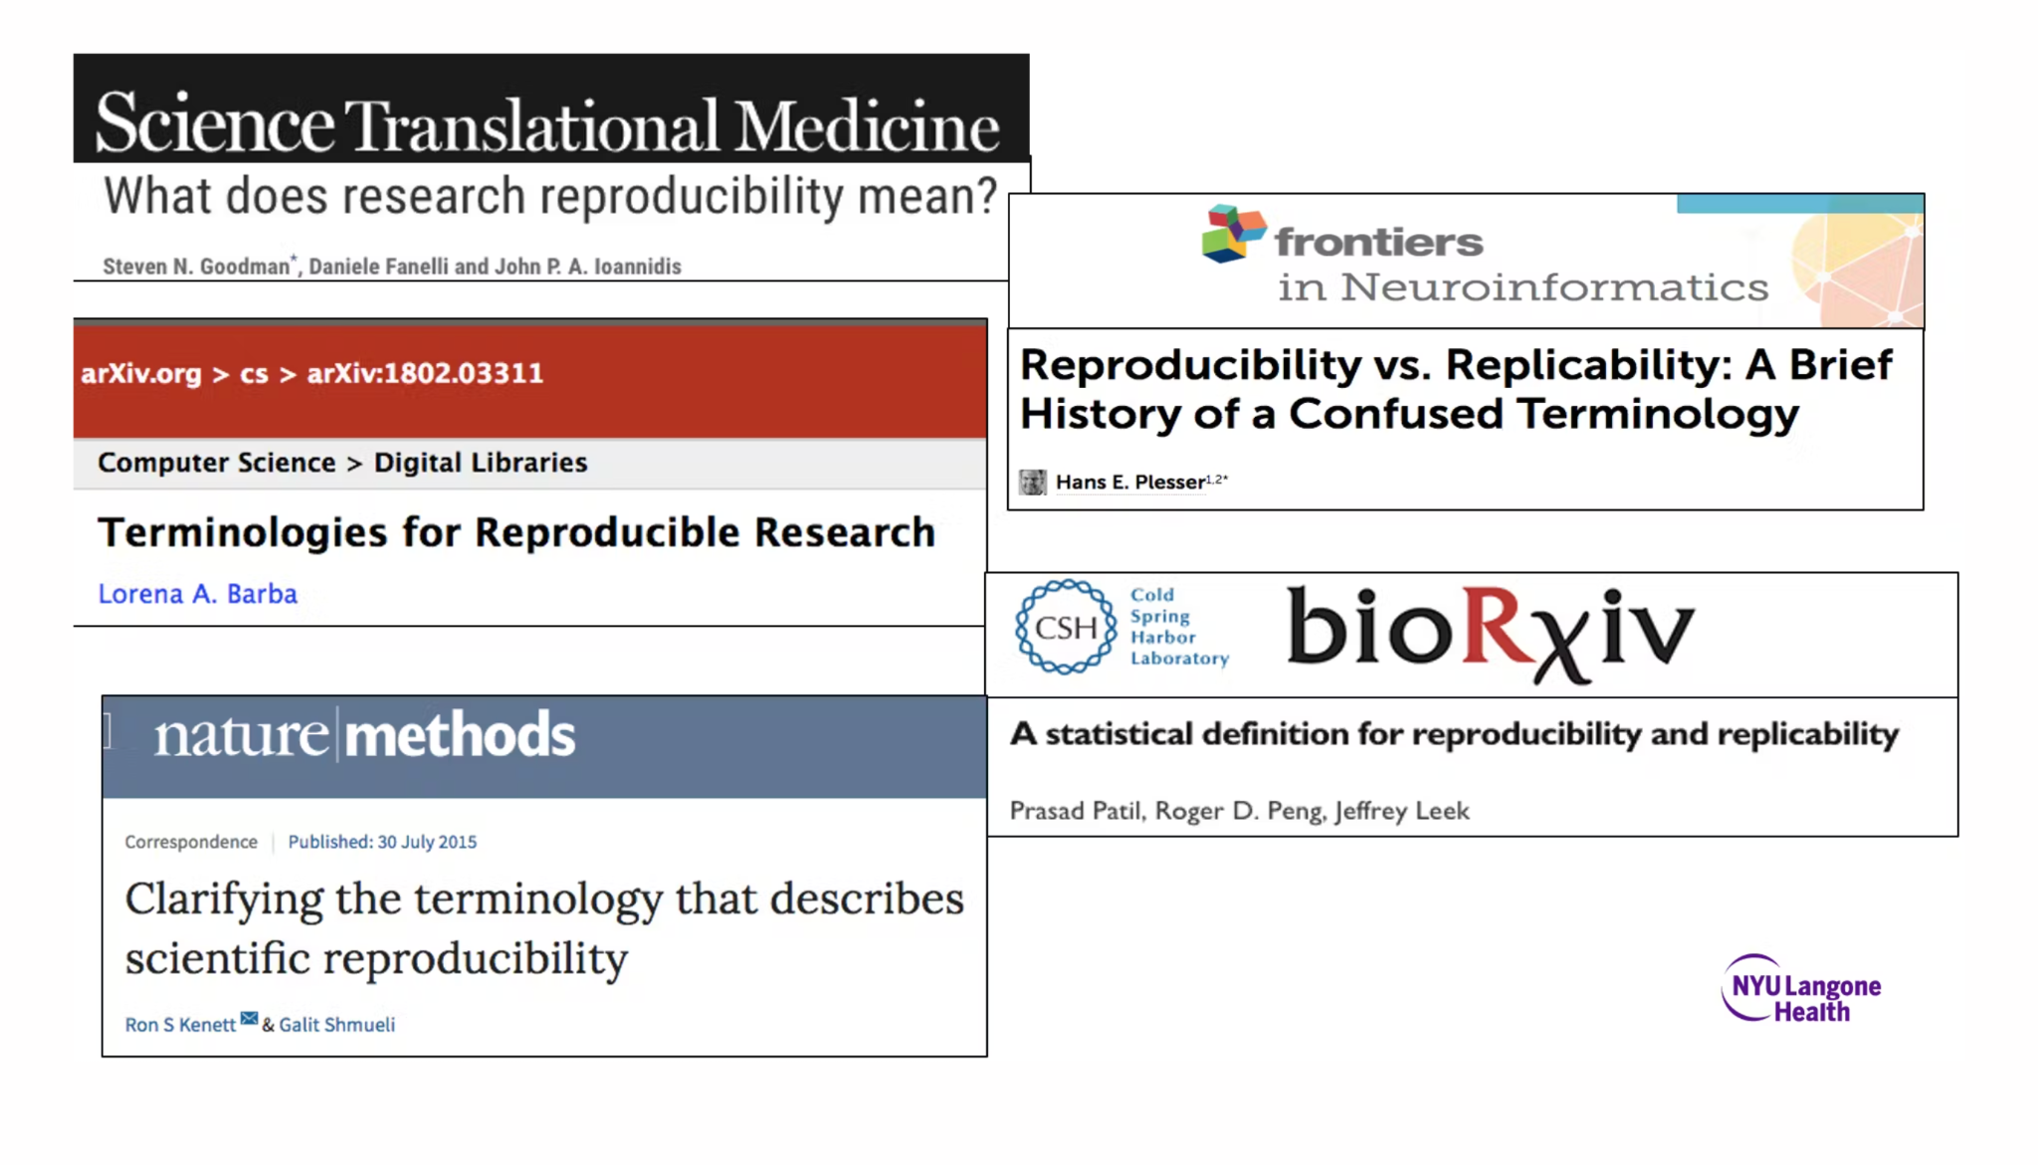
Attention in Scientific Journals

Slide 8
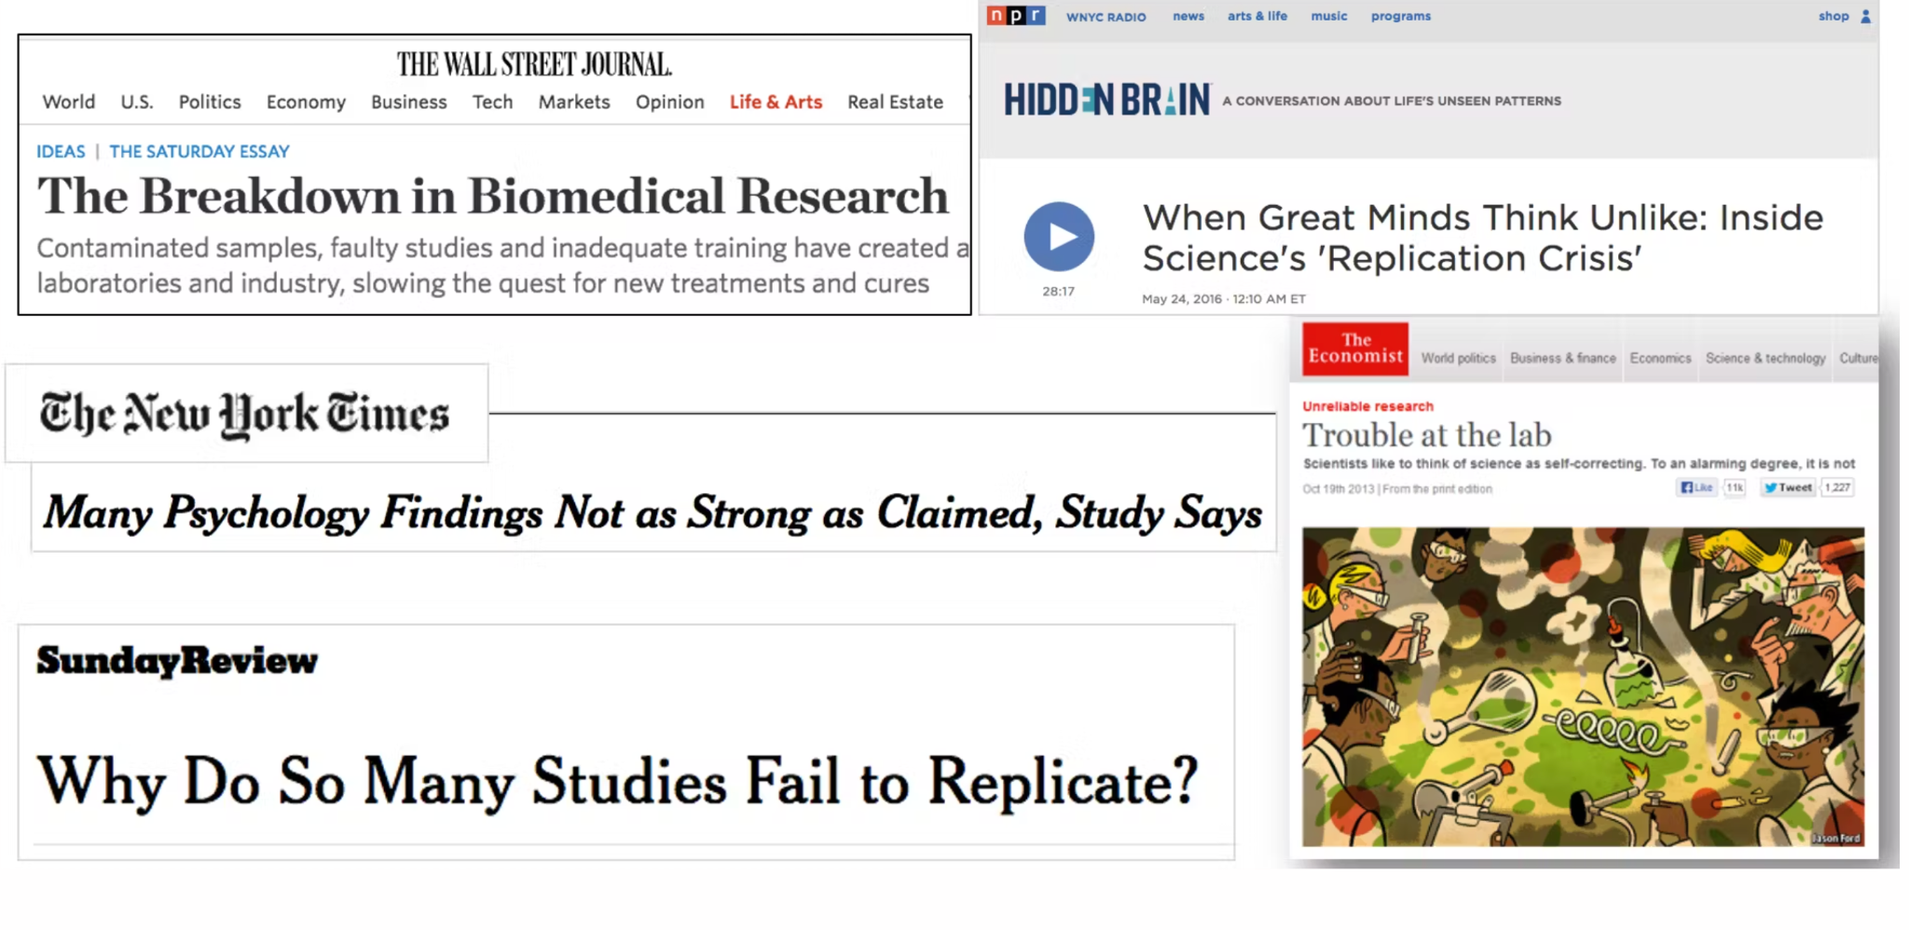
Mainstream Media Attention

Slide 9

National Academies of Sciences 2019 Whitepaper
3 Types of Reproducibility:
Computational Reproducibility: Obtaining consistent results from the same data, computation and analysis
Experimental Replicability: Obtaining consistent results across studies looking at the same question but collecting new data
Generalizability: The extent that one study can apply to other contexts
When someone uses any of these terms, consider or ask what they mean

Slide 10
Inherent Factors Limiting Reproducibility
Complexity of the system being studied
Variation
Variables outside the scope of current knowledge
Limitations of measurements
Prior Probability

Slide 11
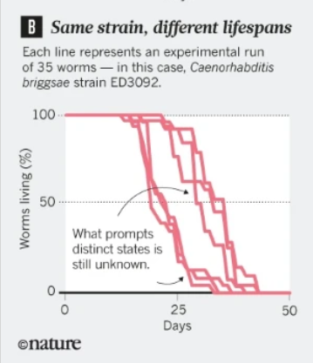
Example
2017 worm aging study (Lithgow, Driscoll and Phillips 2017 “A Long Journey to Reproducible Results”
Following reproducibility challenges, they found that worms were actually partitioned into two cohorts, one with a short and one a long lifespan and required genetic testing to confirm

Slide 12
Problematic Factors Limiting Reproducibility
Poor study design
Failure to follow protocols
Misuse of statistics
Bias
Publication
Population

Slide 13
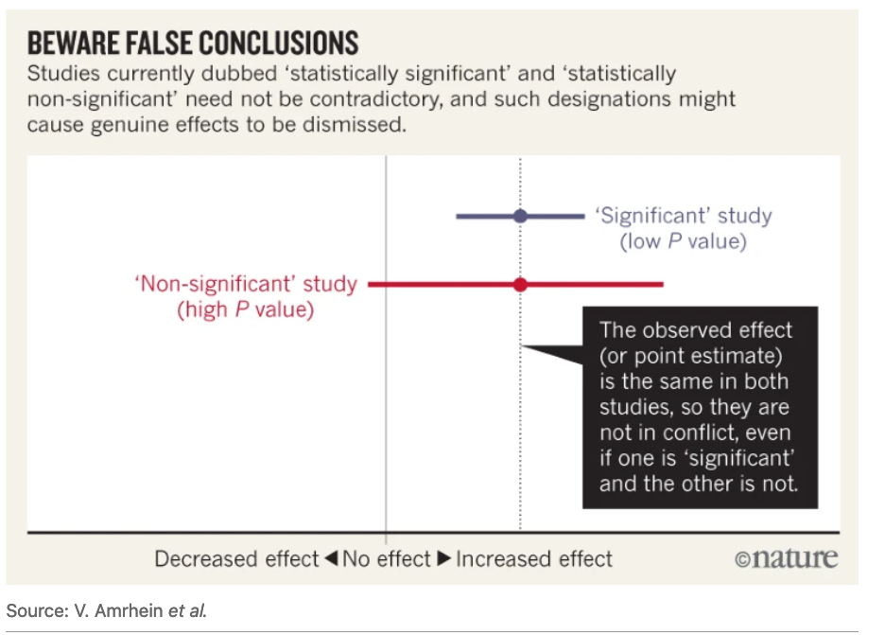
Example
Misunderstandings of the p value for
significance and power abound in basic science literature, and increasingly statisticians are pushing back against the concept of “significance”:
https://www-nature-com.ezproxy.med.nyu.edu/articles/d41586-019-00857-9

Slide 14

In your opinion, is there a reproducibility crisis?
ⓘ
Click Present with Slido or install our Chrome extension to activate this poll while presenting.
Notes:
📣 This is Slido interaction slide, please don't delete it. ✅ Click on 'Present with Slido' and the poll will launch automatically when you get to this slide.

Slide 15

NIH Rigor and Reproducibility Guidelines 2016
Premise
Rigorous Study Design
Relevant Biological Variables
Authentication of Resources

Slide 16
NIH Rigor and Reproducibility Guidelines 2016
Premise
Literature Review
Past Research Experience
Assess Strengths/Weaknesses

Slide 17
NIH Rigor and Reproducibility Guidelines 2016
Rigorous Study Design
Robust, well controlled and replicable experiments.
Clear steps to remove bias: blinding assessors, randomization, clear inclusion/exclusion

Slide 18
NIH Rigor and Reproducibility Guidelines 2016
Relevant Biological Variables
Factor biological variables into research design, analysis and reporting.
Justify if only including one sex.
Cost and absence of known effect not allowed as justification

Slide 19
NIH Rigor and Reproducibility Guidelines 2016
Authentication of Resources
Steps must be taken to explain to reviewers and readers how resources like cell lines or reagents are authenticated.
Providing details on sources can help with this.

Slide 20
NIH Identified Factors Contributing to Issue
Poor experimental design training
Focus on headline grabbing statements
Lack of detail in publications
Publication Bias
Misinterpretation of hypothesis generating research

Slide 21
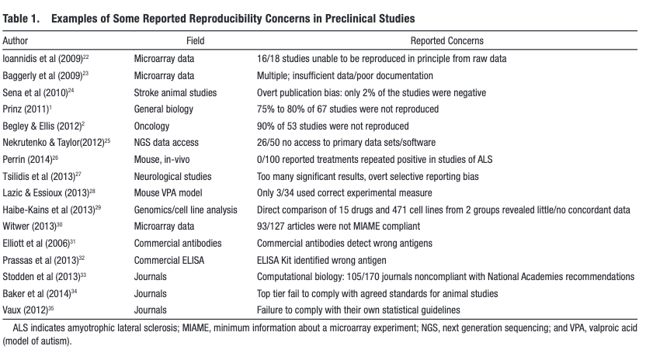
2015 Broad Review
https://www.ahajournals.org/doi/pdf/10.1161/CIRCRESAHA.114.303819

Slide 22
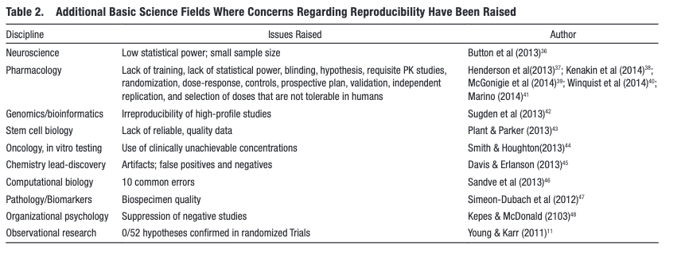
2015 Broad Review
https://www.ahajournals.org/doi/pdf/10.1161/CIRCRESAHA.114.303819

Slide 23
2015 Broad Review
https://www.ahajournals.org/doi/pdf/10.1161/CIRCRESAHA.114.303819

Slide 24
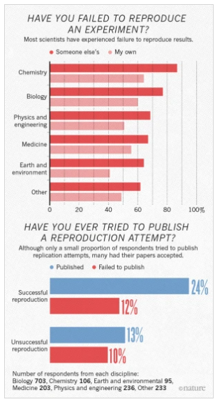
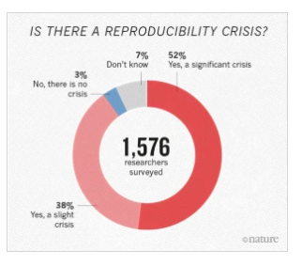
Scientist Survey
https://www.nature.com/articles/533452a

Slide 25
Have you ever tried to replicate someone else's research?
ⓘ
Click Present with Slido or install our Chrome extension to activate this poll while presenting.
Notes:
📣 This is Slido interaction slide, please don't delete it. ✅ Click on 'Present with Slido' and the poll will launch automatically when you get to this slide.

Slide 26
If you tried and were unable to replicate: what were the barriers and what was learned?
ⓘ
Click Present with Slido or install our Chrome extension to activate this poll while presenting.
Notes:
📣 This is Slido interaction slide, please don't delete it. ✅ Click on 'Present with Slido' and the poll will launch automatically when you get to this slide.

Slide 27

What do you feel are the top causes of irreproducibility?
ⓘ
Click Present with Slido or install our Chrome extension to activate this poll while presenting.
Notes:
📣 This is Slido interaction slide, please don't delete it. ✅ Click on 'Present with Slido' and the poll will launch automatically when you get to this slide.

Slide 28
Write Your Headline Here. Use Up to Two Lines
Paragraph Heading
Praesent rhoncus suscipit leo eu auctor. Duis malesuada nisi volutpat, ornare leo eget, congue mauris. Integer sagittis dictum est, et maximus orci porta id. Donec a ligula et tortor vehicula faucibus. Maecenas velit ex, venenatis in commodo vitae, scelerisque vitae enim. Suspendisse vel elementum orci. Vestibulum non lectus ut lorem porttitor vitae. Nullam id rutrum est. Ut a mauris a tellus suscipit aliquet eget vitae nunc.
Aliquam vehicula quam varius massa maximus, eu volutpat enim commodo. iaculis magna. Etiam suscipit in libero at pulvinar. Cras eleifend sapien odio, efficitur tincidunt ligula laoreet quis. Duis sed lectus id neque elementum volutpat non vitae tellus.
Paragraph Heading
Praesent rhoncus suscipit leo eu auctor. Duis malesuada nisi volutpat, ornare leo eget, congue mauris. Integer sagittis dictum est, et maximus orci porta id. Donec a ligula et tortor vehicula faucibus. Maecenas velit ex, venenatis in commodo vitae, scelerisque vitae enim. Suspendisse vel elementum orci. Vestibulum non lectus ut lorem porttitor vitae. Nullam id rutrum est. Ut a mauris a tellus suscipit aliquet eget vitae nunc.
Aliquam vehicula quam varius massa maximus, eu volutpat enim commodo. iaculis magna. Etiam suscipit in libero at pulvinar. Cras eleifend sapien odio, efficitur tincidunt ligula laoreet quis. Duis sed lectus id neque elementum volutpat non vitae tellus.

Slide 29
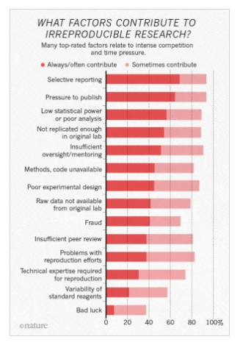
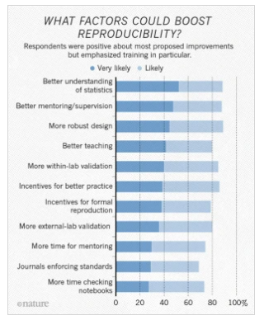
Scientist Survey
https://www.nature.com/articles/533452a

Slide 30
Biological Variables

Slide 31
Biological Variables
The 2016 guidelines require grant submissions to consider biological variables in research:
Sex
Weight
Age
Underlying Health Conditions

Slide 32
Biological Variables
Sex can impact:
Dosing
Presentation
Adverse Events
Presentation
https://pubmed.ncbi.nlm.nih.gov/24857340/
https://pubmed.ncbi.nlm.nih.gov/25686858/

Slide 33
Biological Variables
Of 10 drugs removed from the market 1997-2000, eight were due to effects primarily in biological women.
https://www.gao.gov/products/gao-01-286r

Slide 34
Biological Variables
2021 qualitative study interviewing 62 animal model researchers found conflicting views:
Some in Neuroscience have identified new neural pathways that differ by sex
Others find the requirements onerous due to housing costs and questionable relevance of translation
Some misunderstood the overall requirements regarding power.
https://www.liebertpub.com/doi/pdf/10.1089/jwh.2020.8674

Slide 35
Biological Variables
2021 qualitative study interviewing 62 animal model researchers found conflicting views:
Some in Neuroscience have identified new neural pathways that differ by sex
Others find the requirements onerous due to housing costs and questionable relevance of translation
Some misunderstood the overall requirements regarding power.
https://www.liebertpub.com/doi/pdf/10.1089/jwh.2020.8674

Slide 36
Biological Variables
Concern that the sex as a biological variable may edify socio-cultural views of sex as a binary and ignore presentation of sex characteristics on a spectrum
Pape notes that some issues that may at first relate to sex as a biological variable, may may on further reflection be a contextual issue.
https://www.tandfonline.com/doi/full/10.1080/14461242.2021.1969981

Slide 37
Biological Variables
Sex is one of many variables.
Star Methods (Cell) call for: detailed information related to the species, strain and backcrossing status, developmental stage, weight, genotype, health/immune status, drug or test naive, previous procedures, housing, and husbandry.
https://www.cell.com/pb-assets/journals/research/cell/methods/Methods_Guide_general-1678470557763.pdf

Slide 38
Biological Variables
Nature’s Guidelines Checklist similarly call for species, strain, sex and age.
https://www.nature.com/documents/Reporting_checklist_new.doc
Arrive guidelines call for clear definitions of sample size, experimental unit, and inclusion/exclusion criteria:
https://arriveguidelines.org/arrive-guidelines/inclusion-and-exclusion-criteria/3c

Slide 39
What do you feel are benefits and drawbacks of inclusion of biological variables, especially sex?
ⓘ
Click Present with Slido or install our Chrome extension to activate this poll while presenting.
Notes:
📣 This is Slido interaction slide, please don't delete it. ✅ Click on 'Present with Slido' and the poll will launch automatically when you get to this slide.

Slide 40
Publication Bias

Slide 41
Positive Findings are More likely to be published
2016 JAMA paper, in an issue focused on p values, noted that usage of p values had increased since 1990, and 96% of published research in their review yielded positive findings, i.e. had a p value of less than .05.
https://jamanetwork.com/journals/jama/fullarticle/2503172

Slide 42
Pre-Registration of Research May be One Solution
Increasing numbers of journals allow pre-registration, for example PLOS, and sites like the Center for Open Science also promote it as a way to increase reliability.
https://plos.org/open-science/preregistration/
https://www.cos.io/initiatives/prereg

Slide 43
As a researcher, what are some ways you might account for publication bias (the idea that positive findings are more likely to get published)?
ⓘ
Click Present with Slido or install our Chrome extension to activate this poll while presenting.
Notes:
📣 This is Slido interaction slide, please don't delete it. ✅ Click on 'Present with Slido' and the poll will launch automatically when you get to this slide.

Slide 44
Ways to cope with publication bias
Cast a wide net in your researching
Consider conference abstracts
Pay attention to hypothesis generating vs. testing research

Slide 45
Review

Slide 46
From a research standpoint, why does the NIH require sex as a biological variable to be accounted for in research studies?
ⓘ
Click Present with Slido or install our Chrome extension to activate this poll while presenting.
Notes:
📣 This is Slido interaction slide, please don't delete it. ✅ Click on 'Present with Slido' and the poll will launch automatically when you get to this slide.

Slide 47
Which element of the NIH guidelines can be addressed by thoroughly documenting strengths and weaknesses of the available literture?
ⓘ
Click Present with Slido or install our Chrome extension to activate this poll while presenting.
Notes:
📣 This is Slido interaction slide, please don't delete it. ✅ Click on 'Present with Slido' and the poll will launch automatically when you get to this slide.

Slide 48
Publication bias refers to....
ⓘ
Click Present with Slido or install our Chrome extension to activate this poll while presenting.
Notes:
📣 This is Slido interaction slide, please don't delete it. ✅ Click on 'Present with Slido' and the poll will launch automatically when you get to this slide.

Slide 49
Explain the general idea of the reproducibility crisis and give an example of something that may be contributing to it.
ⓘ
Click Present with Slido or install our Chrome extension to activate this poll while presenting.
Notes:
📣 This is Slido interaction slide, please don't delete it. ✅ Click on 'Present with Slido' and the poll will launch automatically when you get to this slide.

Slide 50
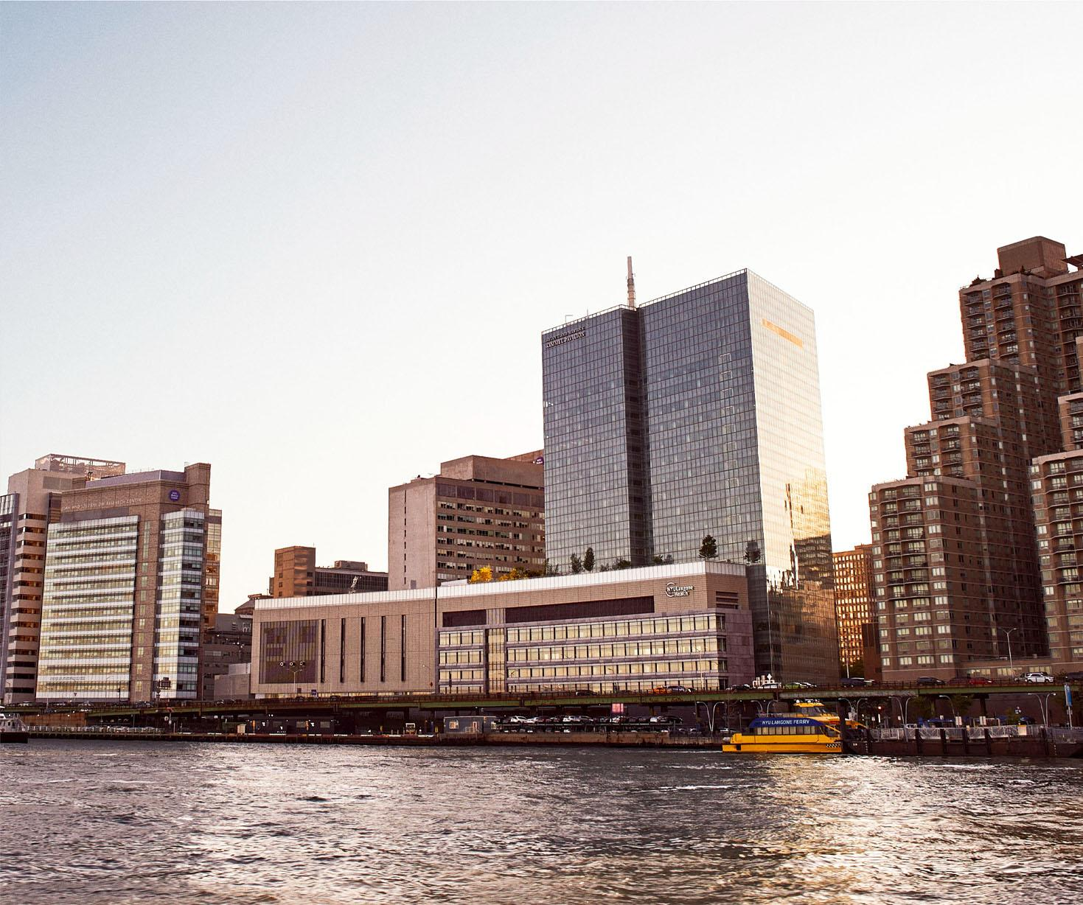
Homework
Write a 300 word reflection on inclusion of biological variables in research, such as sex, weight, underlying conditions. Explain how these may pertain to your area of research, limitations that may make it more challenging to include these features in papers, benefits of presenting the information to others. When reading literature have you always found this information is clear, and how might that impact your understanding of the research and the reproducibility of the paper as it relates to your field? Be specific.

Slide 51
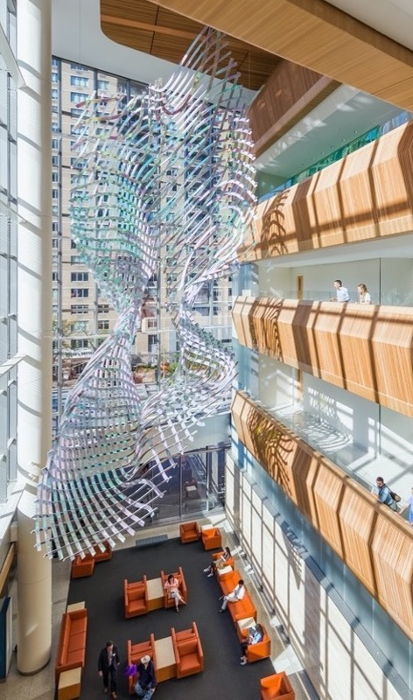
Have a great week!
fred.lapolla@nyulangone.org

Slide 52
References
1. Preregistration [Internet]. PLOS. [cited 2023 Aug 15]. Available from: https://plos.org/open-science/preregistration/
2. Science C for O. Preregistration [Internet]. [cited 2023 Aug 15]. Available from: https://www.cos.io/initiatives/prereg
3. Lithgow GJ, Driscoll M, Phillips P. A long journey to reproducible results. Nature. 2017 Aug;548(7668):387–8.
4. Waltz M, Fisher JA, Lyerly AD, Walker RL. Evaluating the National Institutes of Health’s Sex as a Biological Variable Policy: Conflicting Accounts from the Front Lines of Animal Research. J Womens Health. 2021 Mar;30(3):348.
5. Franconi F, Campesi I. Sex and gender influences on pharmacological response: an overview. Expert Rev Clin Pharmacol. 2014 Jul;7(4):469–85.
6. Festing MFW. The “completely randomised” and the “randomised block” are the only experimental designs suitable for widespread use in pre-clinical research. Sci Rep. 2020 Oct 16;10(1):17577.
7. Chavalarias D, Wallach JD, Li AHT, Ioannidis JPA. Evolution of Reporting P Values in the Biomedical Literature, 1990-2015. JAMA. 2016 Mar 15;315(11):1141–8.
8. Baker M. 1,500 scientists lift the lid on reproducibility. Nature. 2016 May 1;533(7604):452–4.
9. Reproducibility and Replicability in Science [Internet]. Washington, D.C.: National Academies Press; 2019 [cited 2023 Aug 15]. Available from: https://www.nap.edu/catalog/25303
10. Amrhein V, Greenland S, McShane B. Scientists rise up against statistical significance. Nature. 2019 Mar;567(7748):305–7.
11. Pape M. Lost in translation? Beyond sex as a biological variable in animal research. Health Sociol Rev. 2021 Aug 27;0(0):1–17.
12.Hirst JA, Howick J, Aronson JK, Roberts N, Perera R, Koshiaris C, et al. The Need for Randomization in Animal Trials: An Overview of Systematic Reviews. PLOS ONE. 2014 Jun 6;9(6):e98856.

